Slide 1





FIT5145
FOUNDATIONS OF DATA SCIENCE
ASSIGNMENT 3
TOPIC: PREDICTIVE MODELING OF MAX VERSTAPPEN’S F1 PERFORMANCE
Presented by
Bharath Arun Gandhimani Student ID: 35501308

Slide 2

INTRODUCTION
This project analyzes Max Verstappen to deliver data-driven strategies for enhancing performance.
To explain and predict his performance variability influenced by circuit type, competitor strength, and seasonal trends.

Slide 3
OBJECTIVES
01
Analyze factors influencing Max Verstappen's finishing positions (e.g., grid position, pit stops).
02
Develop a predictive model to forecast race outcomes using features like qualifying gap and constructor momentum
03
Quantify relationships between operational metrics (pit stop duration, lap time) and results
04
Examine temporal performance trends using rolling averages to understand form momentum.

Slide 4
OBJECTIVES
05
Visualize race patterns through extensive exploratory data analysis (EDA).
06
Validate model performance using statistical measures (RMSE, MAE) on training and test data.
07
Apply the model dynamically to forecast future races (e.g., the 2025 Italian Grand Prix).

Slide 5
RELATED WORK
Existing F1 Analytics Landscape:
Limitations of Current Approaches:
Teams invest heavily in telemetry and machine learning for strategy refinement
Prior research (Koh, 2024) analyzed historical race outcomes using descriptive techniques
Predictive models often rely on proprietary datasets with complex simulations
Not publicly accessible
Focus on broad aggregates rather than driver-specific analysis
Limited democratization of insights

Slide 6
BUSINESS MODEL - STAKEHOLDERS
Primary Beneficiaries:
Drivers & Race Engineers - refine pre-race preparation and in-race decision-making.
Team Strategists (Red Bull Racing) - Optimize pit-stop timing, tire strategy, and rival analysis
F1 Management & Sponsors - Highlight performance narratives to engage fans and improve brand value
Fans & Media Analysts - Access deeper insights about race strategy beyond surface-level statistics

Slide 7
VALUE PROPOSITION
Broader Applications:
Scalable Beyond Motorsport
Methodology applicable to industries where proprietary analytics create barriers
Demonstrates how transparent, data-driven insights level the playing field
Societal Impact
Democratizes knowledge normally siloed within elite organizations
Empowers students, educators, independent analysts, and fans
Fosters STEM learning and data literacy in broader society
Impact Summary: Advances competitive fairness within F1 while illustrating social and commercial impact of open-data science in data-intensive fields.

Slide 8
DATA SOURCES AND CHARACTERISTICS
Primary Dataset:
Formula 1 World Championship dataset (1950–2024) from Kaggle
Big Data Characteristics:
Volume: Over seventy years of racing history with thousands of records capturing race-by-race granularity
Variety: Numerical timing metrics, categorical identifiers (driverId, constructorId), text (race names), geospatial variables (altitude, latitude, longitude)
Velocity: Static and historical data; no real-time ingestion required
Veracity: Rigorously cleaned to handle missing values (encoded as "\N" or blanks) and convert character timings to numeric forms

Slide 9
PLATFORMS, SOFTWARE, AND TOOLS
Data processing uses R and R Markdown for reproducibility, visualization (ggplot2), and modeling (randomForest).
The combination offers flexibility for statistical computing, visualization, and report generation.
The workflow is scalable with relational joins handling multi-table data, and modeling adapts for non-linear effects critical in sports analytics.

Slide 10
DATA ANALYSIS TECHNIQUES AND STATISTICAL METHODS
EDA using correlation matrices, histograms, scatterplots, and smoothing lines identified key predictors of finishing position, including grid position, qualifying gap, pit stop efficiency, and recent constructor points.
Random forest regression was chosen for its robustness to nonlinearity, mixed data types, and overfitting resistance. It captures complex feature interactions (e.g., qualifying gaps with pit stop strategies) better than linear models, matching the multifactor nature of racing outcomes.
The expected result is a predictive model estimating finishing positions and supporting strategic race simulations.

Slide 11
DEMONSTRATION
Objective: To demonstrate the feasibility and validity of the proposed data science approach for understanding and predicting Max Verstappen’s F1 race performance.
Dataset: The analysis uses the Kaggle Formula 1 World Championship dataset (1950–2024)

Slide 12
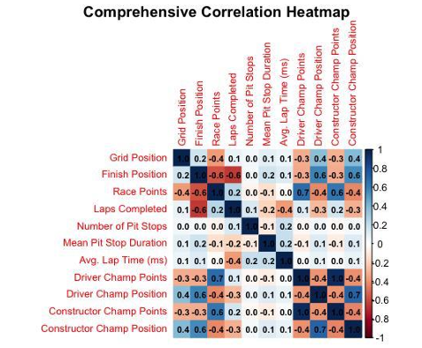
PRELIMINARY EDA
(BEFORE FEATURE ENGINEERING)
An initial exploratory data analysis was performed prior to feature engineering to examine relationships among key race-related variables and to identify meaningful predictors for modeling.
Grid Position vs. Finish Position: A moderate positive correlation (about 0.2), meaning drivers starting closer to the front grid tend to finish nearer the front, but start position isn’t everything.
Finish Position vs. Race Points: A strong negative correlation (approx -0.8). This makes sense: lower (better) finishing positions yield more points in F1 scoring (P1 > P2 >) .
Race Points and Championship Points: Strong positive relationships (0.7+), as more race points lead to increased season points for both drivers and constructors.
Championship Points vs. Championship Position: Strong negative correlation (approx -0.8), as more points mean a better (lower) ranki

Slide 13
DATA CLEANING AND PREPARATION
Datasets were imported into the R environment and standardized using helper functions.
Missing values encoded as “\N” or blanks were recoded to NA for consistency.
Key transformations included converting time strings (e.g., “1:26.000”) into numeric seconds and ensuring correct categorical identifiers for merging multiple data sources.

Slide 14
FEATURE ENGINEERING
To capture both driver strategy and contextual effects particular to Max Verstappen's performance, new predictive features were computed exclusively from his race and qualifying data. These features aimed to characterize Verstappen's competitive profile and race conditions impact:
Best Qualifying Lap (sec): For each race, Verstappen’s fastest valid qualifying lap was calculated by taking the minimum among his q1, q2, and q3 times.
Pit Stop Metrics: The total number of pit stops and their average duration for Verstappen per race were summarized to reflect his pit strategy and efficiency.
Average Lap Time (ms): Verstappen’s mean lap time per race was computed to approximate his race pace and consistency.
Rolling Averages: Rolling three-race averages of Verstappen’s recent finishing positions and constructor points illustrated his form momentum over time.
Qualifying Gap (qgap): His qualifying time gap relative to the race pole position was calculated as a measure of starting grid competitiveness

Slide 15
EXPLORATORY DATA ANALYSIS (POST-FEATURE ENGINEERING)
After constructing a comprehensive set of engineered features focused on Max Verstappen’s race and qualifying performance, further detailed exploratory data analysis confirmed several important insights:
Dominance of Grid Position and Constructor Points: The correlation matrix revealed a strong and consistent influence of Verstappen’s grid position on his finishing position.
Starting near the front substantially increases the likelihood of a podium or race win.

Slide 16
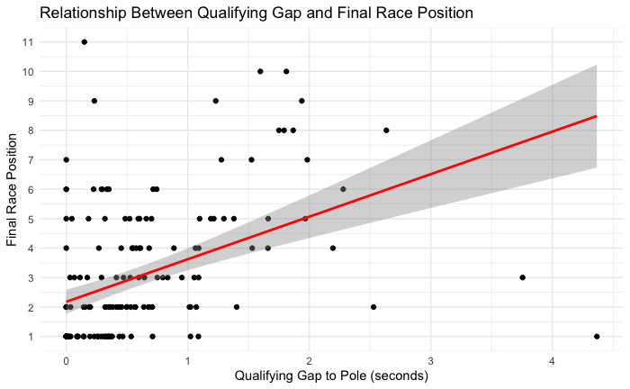
POSITIVE CORRELATION BETWEEN QUALIFYING GAP AND FINISH POSITION:
Visualizations plotting Verstappen’s qualifying gap shows that the time difference from the pole position lap against his finishing position illustrates a clear upward trend. Smaller gaps correlated with top finishes, confirming that qualifying performance is a key predictor of race success.
However, the data also showed exceptions where Verstappen overcame larger qualifying gaps through superior racecraft or strategy.

Slide 17
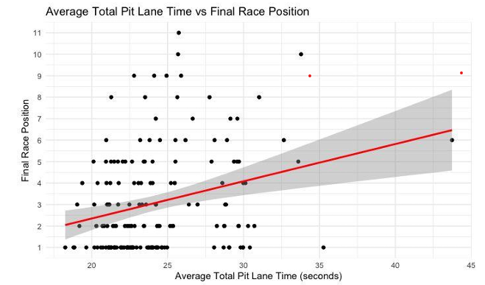
COMPLEX PIT STOP STRATEGY RELATIONSHIPS
Pit stop metrics such as the number of stops and average pit stop duration exhibited intricate patterns.
Most races involved one or two pit stops, but some races with multiple stops or longer average pit durations still resulted in wins.
This indicates that while efficient pit stops generally improve race outcomes, Verstappen’s skill and tactical decisions can mitigate less optimal pit scenarios.

Slide 18
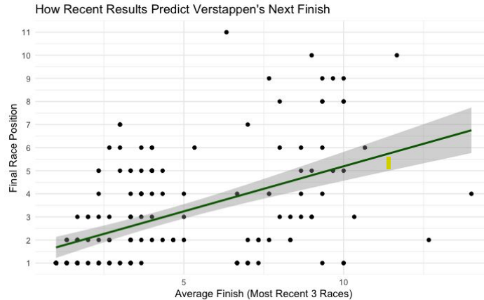
INFLUENCE OF RECENT DRIVER FORM (ROLLING MEAN FINISH POSITION):
Aparticularly strong relationship emerged between Verstappen’s average finish over the previous three racesandhis subsequent raceresult.
This rolling mean finish position proved to be a valuable predictor of near-term performance, indicating that momentum and consistency significantly contribute to race outcomes.
The trend suggests that Max Verstappen’s recent performance trajectory is a critical context factor shaping his success, reflecting both psychological confidence and stable operational conditions.

Slide 19
TRAIN-TEST SPLIT AND MODEL DESIGN
Data Splitting:
80% training data
20% test data
Ensured representative coverage
Predictor Variables: Grid position, squared grid, qualifying gap, pit stop count and duration, recent constructor form, constructor wins, recent driver finishes, altitude, latitude, longitude, temporal features (year and round)

Slide 20
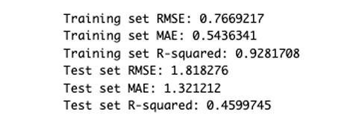
MODEL TRAINING AND EVALUATION
A random forest regression model was trained using repeated 5-fold cross-validation to optimize predictive accuracy and reduce overfitting, selecting RMSE as the tuning metric.
The model performed well, achieving low root mean squared error and mean absolute error on both training and test data, as well as high R-squared values indicating strong explanatory power.
Residuals showed limited error variance, primarily due to unpredictable race events.

Slide 21
PREDICTION - 2025 ITALIAN GRAND PRIX
Model Application:
Input Parameters:
Starting grid position: 2
Qualifying gap: 75.5 seconds
Pit stops: 2 stops averaging 2.5 seconds
Constructor points, recent form, and Monza circuit characteristics
Predicted Outcome:
Finishing position: 2.76
Interpretation: Podium finish or likely victory
Actual Result: 1st place in the actual race
Validation: Model successfully predicted top-tier performance

Slide 22
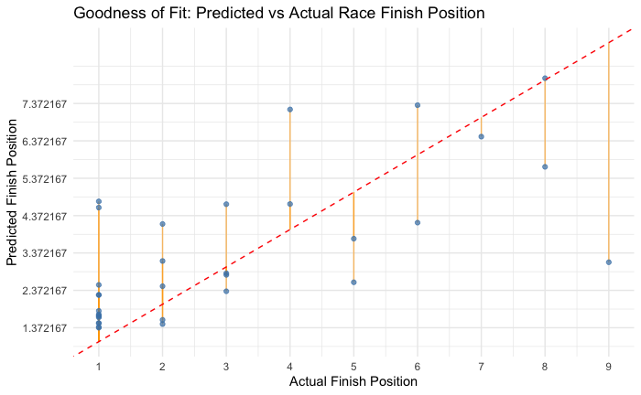
GOODNESS-OF-FIT VISUALIZATION
Model Performance Analysis:
Strengths:
Most predicted values for high finishes (1st or 2nd) close to actual results
Clustering near identity line demonstrates accuracy for dominant winning tendencies
Model captures top results effectively
Limitations:
Less precise for lower finish positions
Greater error and variability when Verstappen finishes further down the order
Spread of points reflects rare, less typical race scenarios
Overall Assessment: Model reliably forecasts top results but shows limitations in uncommon racing outcomes

Slide 23
REFERENCES
Rao, R. (2025). Formula 1 World Championship (1950-2024) [Dataset]. Kaggle.
Breiman, L. (2001). Random forests. Machine Learning, 45(1), 5–32.
Ditroilo, M. (2025). Exploratory research in sport and exercise science. Journal of Sports Sciences.
Kuhn, M. (2008). Building Predictive Models in R Using the caret Package. Journal of Statistical Software, 28(5).
Weissbock, J., & Mills, S. (2025). Evaluating the predictive power of qualifying performance in Formula One Grand Prix. arXiv Preprint.
R Core Team. (2024). R: A Language and Environment for Statistical Computing. Vienna, Austria: R Foundation for Statistical Computing.
Cole, N. L. (2024). The societal impact of open science: A scoping review. PLoS ONE, 19(6), e261965.

Slide 24

THANK
YOU

